Slide 1


Machine Learning:
Disease Prediction
Athen Osterberg
Heather Shoberg
Mi Thao
Lori Vitaioli
Notes:
Mi Chue

Slide 2

Train a machine learning model to predict what disease a patient might have based on their symptoms
Objective
Notes:
Mi Chue

Slide 3
Steps
1
Determine which data set to use and pre-process the data
2
Develop four machine learning models to make predictions of diseases based on symptoms
3
Optimize models to reach 75%+ accuracy
Create a “Disease Predictor” application using HTML, flask, and a machine learning model that can predict a user’s potential disease based on the symptoms they input
4
Notes:
Heather

Slide 4
Data Set
Kaggle:
Disease Symptom Prediction
41 Diseases
120 Rows of
Symptom Data
per Disease
Up to 17 Symptoms per Disease
Notes:
Heather

Slide 5





Data Pre-Processing
Narrowed diseases down from 41 → 10
Allergy; Drug Reaction; Migraine; Common Cold; Pneumonia; Heart Attack; Fungal Infection; Hypoglycemia; Urinary Tract Infection; Chicken Pox
1
Separated data into:
Features: Symptoms
Output: Disease
2
Encoded the string data
Symptoms encoded into 0 & 1
Diseases encoded from 0:9
3
Concatenated features and output data
4
Converted dataframe into table in a
SQLite database
5
Notes:
Lori

Slide 6
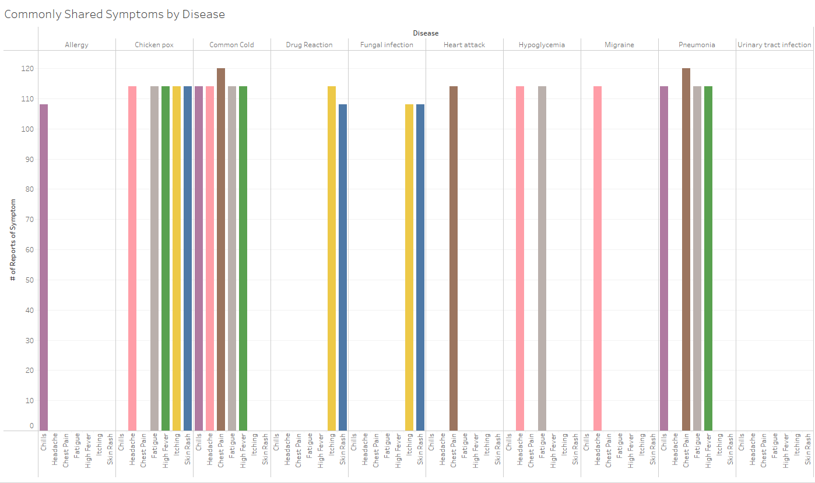
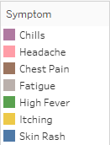
Initial Data Analysis
51
Total
Symptoms
7
Symptoms
Compared
Notes:
Lori
After narrowing down to 10 diseases, there were 51 remaining symptoms in the dataset
Analyzed symptoms that were present in 3 or more of the diseases in the dataset (7 symptoms out of 51 total symptoms)
Trends
Common Cold and Pneumonia share 4 out of 5 common symptoms being represented
Drug Reaction and Fungal Infection patients commonly report itching and skin rash
Urinary Tract Infection did not share any common symptoms (Bladder Discomfort, Burning Micturition, Continuous Feel of Urine, Foul Smell of Urine) - shares burning micturition with drug reaction

Slide 7
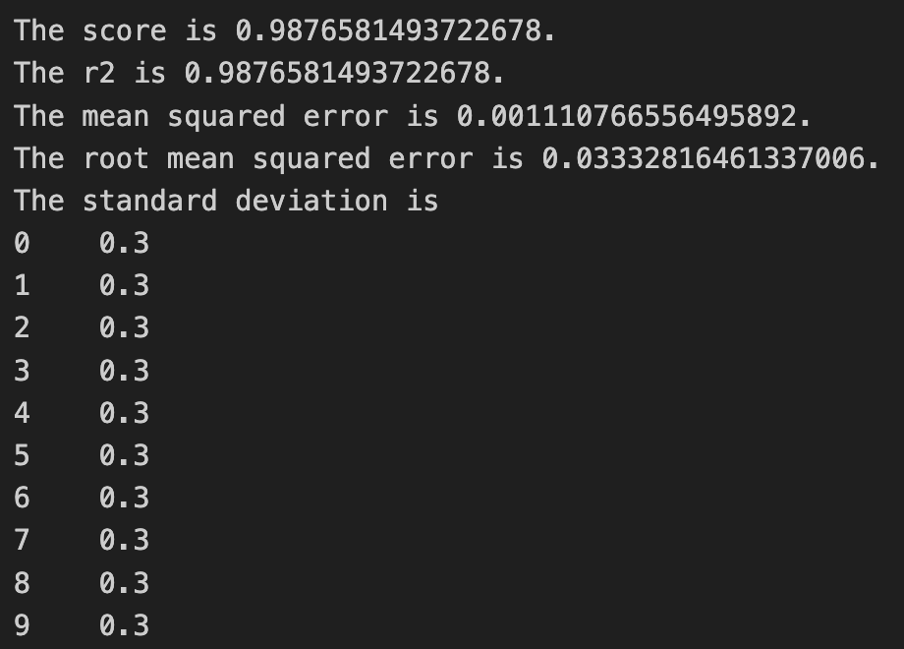
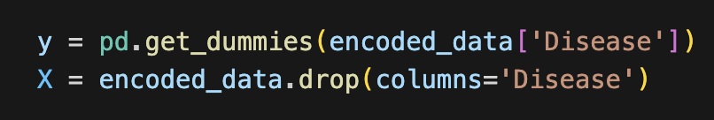
ML #1 - Linear Regression
X values are symptoms
y value is the diseases column
Y needs to be split into dummies since it is categorical
Fit a model using sklearn linear regression

Slide 8
ML #2 - Logistic Regression
Disease Value | Disease | Precision | Recall | F1-Score | Support
Disease 0 | Allergy | 1.00 | 1.00 | 1.00 | 21
Disease 1 | Chicken Pox | 1.00 | 1.00 | 1.00 | 23
Disease 2 | Common Cold | 1.00 | 1.00 | 1.00 | 24
Disease 3 | Drug Reaction | 1.00 | 1.00 | 1.00 | 23
Disease 4 | Fungal Infection | 1.00 | 1.00 | 1.00 | 23
Disease 5 | Heart Attack | 1.00 | 1.00 | 1.00 | 33
Disease 6 | Hypoglycemia | 1.00 | 1.00 | 1.00 | 19
Disease 7 | Migraine | 1.00 | 1.00 | 1.00 | 22
Disease 8 | Pneumonia | 1.00 | 1.00 | 1.00 | 24
Disease 9 | Urinary tract infection | 1.00 | 1.00 | 1.00 | 25
---------------------------------------------------------------------------------------------------------------------
 | Accuracy | - | - | 1.00 | 240
 | Macro Avg | 1.00 | 1.00 | 1.00 | 240
 | Weighted Avg | 1.00 | 1.00 | 1.00 | 240
The classification report shows strong performance, with precision, recall, and F1-scores of 1.00 across all diseases. This combined with the overall accuracy of 1.00 indicates high accuracy in identifying diseases based on the dataset of symptoms used.

Slide 9
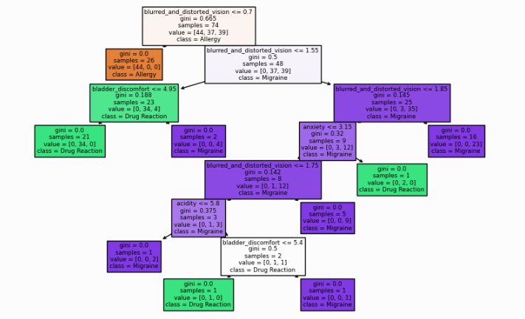
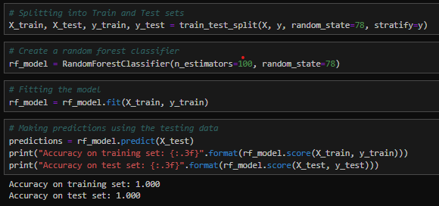
ML #3 - Random Forest
Training/Testing sets based on 10 random diseases and their symptoms.
RF Classifier n_estimators 10 gave a 99% level of accuracy
RF Classifier n_estimators 100 gave a 100% level of accuracy
*Example decision tree from random forest model featuring blurred and distorted vision symptom
Notes:
Heather

Slide 10
ML #4 - Neural Network
Version 1
Version 2
Layers Breakdown:
1st Layer:
10 Input Dimensions
10 Nodes
Relu Activation Function
2nd Layer:
10 Nodes
Relu Activation Function
Output Layer:
10 Nodes
Softmax Activation Function
Layers Breakdown:
1st Layer:
10 Input Dimensions
20 Nodes
Relu Activation Function
2nd Layer:
10 Nodes
Relu Activation Function
Output Layer:
10 Nodes
Softmax Activation Function
Accuracy: 98.3%
Accuracy: 100%
Notes:
Lori

Slide 11
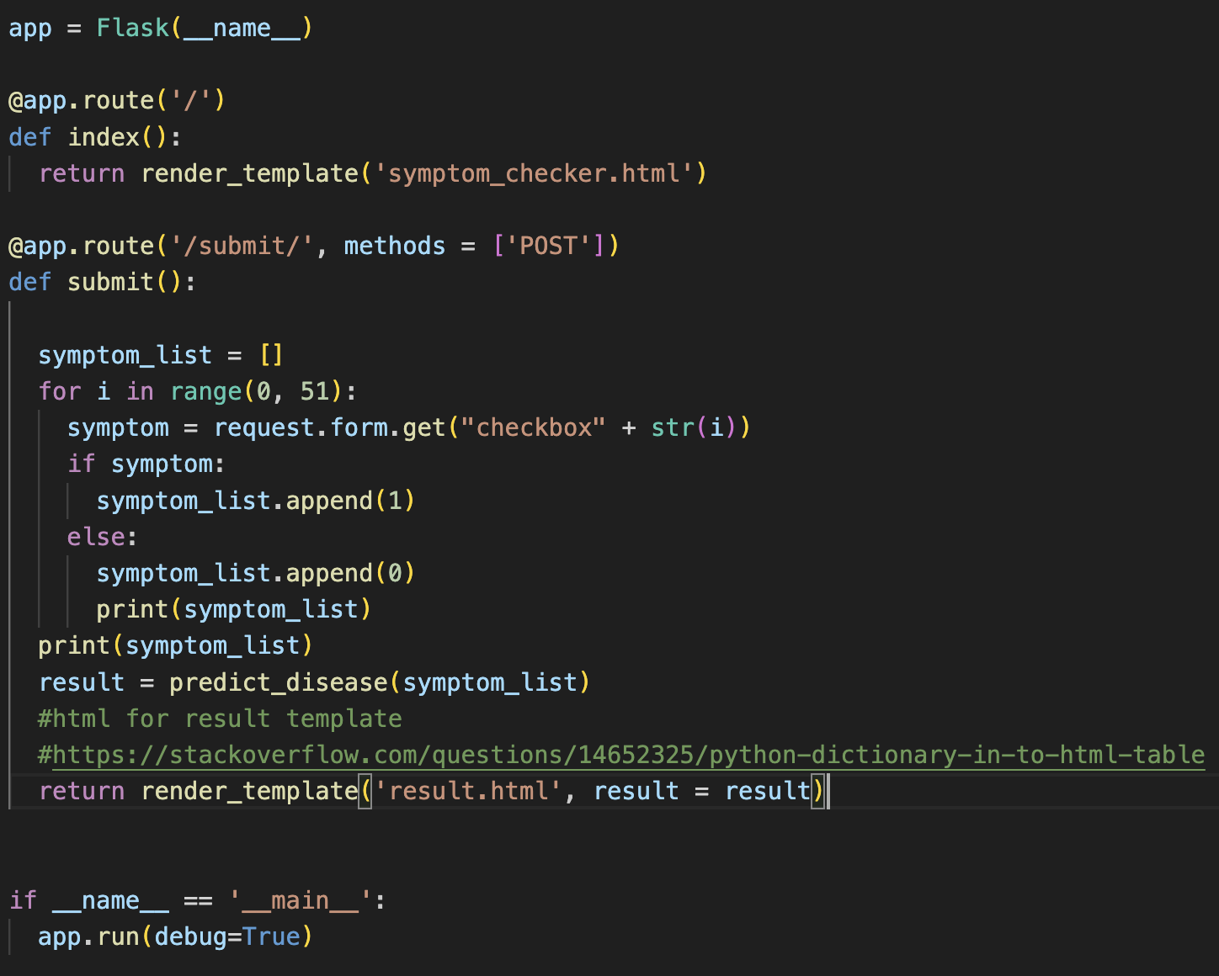
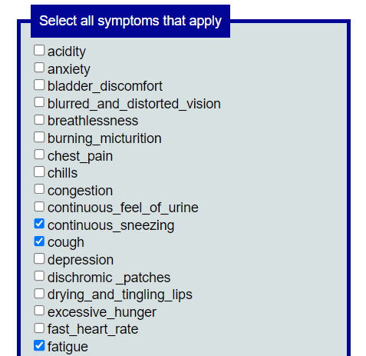
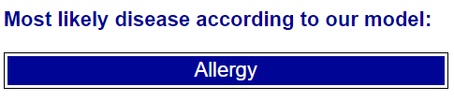
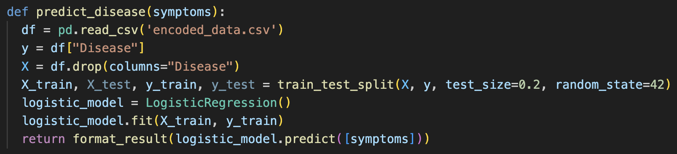
Disease Prediction Flask API
Notes:
Athen

Slide 12

Conclusion & Next Steps
¾ of the machine learning models achieved 100% accuracy The models were able to easily interpret the dataset due to the consistency of symptoms for each disease
Limitations Only selecting 10/41 diseases in the dataset means the model is limited in what it can predict
What’s next? Add more data to the model: the other 31 diseases not initially included and more beyond those
Machine learning models like these can assist medical professionals when diagnosing patients, which can lead to more efficient treatment. However, a model alone should not be used as a diagnosis tool
Notes:
Mi Chue

Slide 13
Questions?

